Slide 1
Solving Sudoku with Grover's Algorithm
#46
Kentaro Tamura, Keisuke Kato,
Hiroki Yamazaki, Yohei Ibe
(Coach: Ayumu Shiraishi)

Slide 2
Contents
Introduction
Methods
Results
Conclusion & Future Work

Slide 3
Introduction

Slide 4
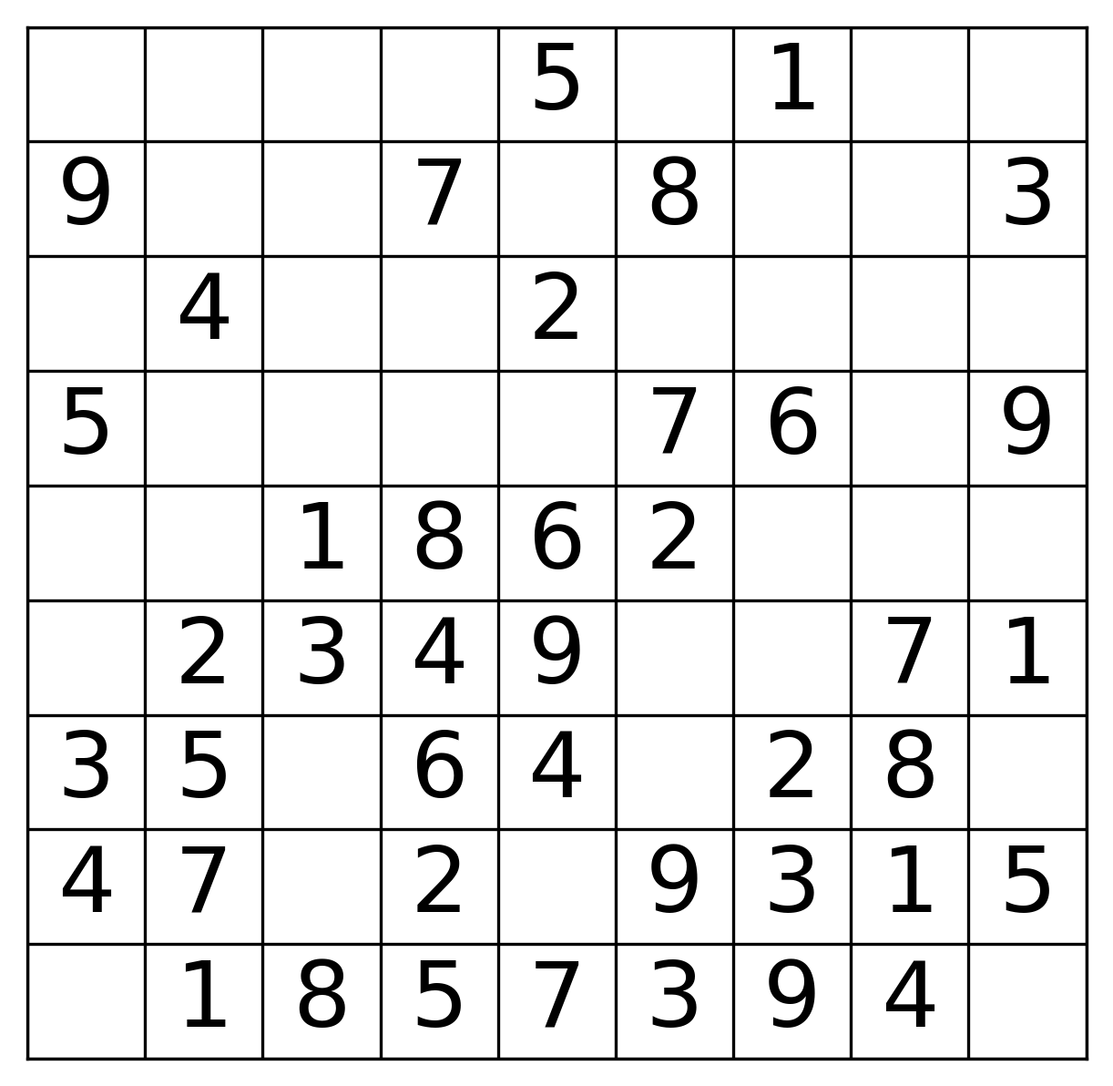
What is Sudoku?
Introduction
Fill in the blanks
Each row, column, block must contain all numbers 1, 2, … , 9
9
9

Slide 5
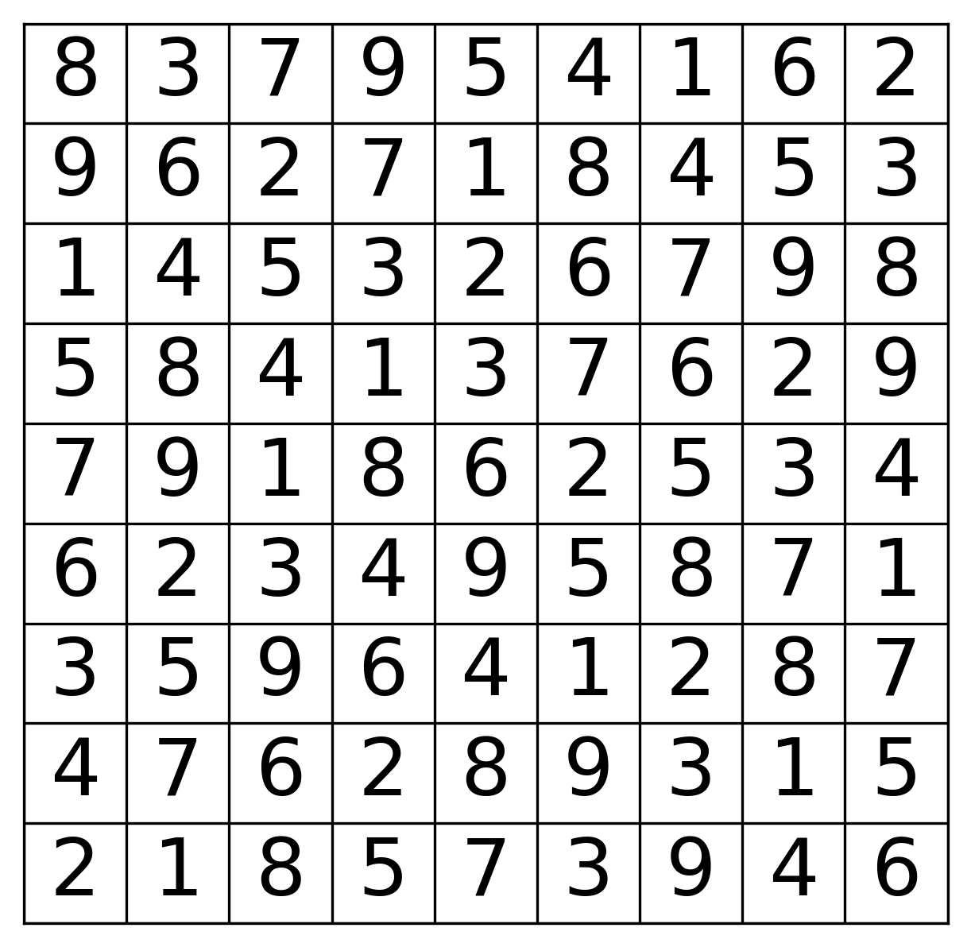
What is Sudoku?
Introduction
Box: 1 ~ 9
Row: 1 ~ 9
Column: 1 ~ 9

Slide 6

Why use a Quantum Computer?
Introduction
Quantum computers can search all candidates for every blank cell,
“simultaneously”

Slide 7

What is Grover’s algorithm?
Introduction
Given input N, Grover’s algorithm searches and finds the correct answer with less steps than classical algorithms.

Slide 8
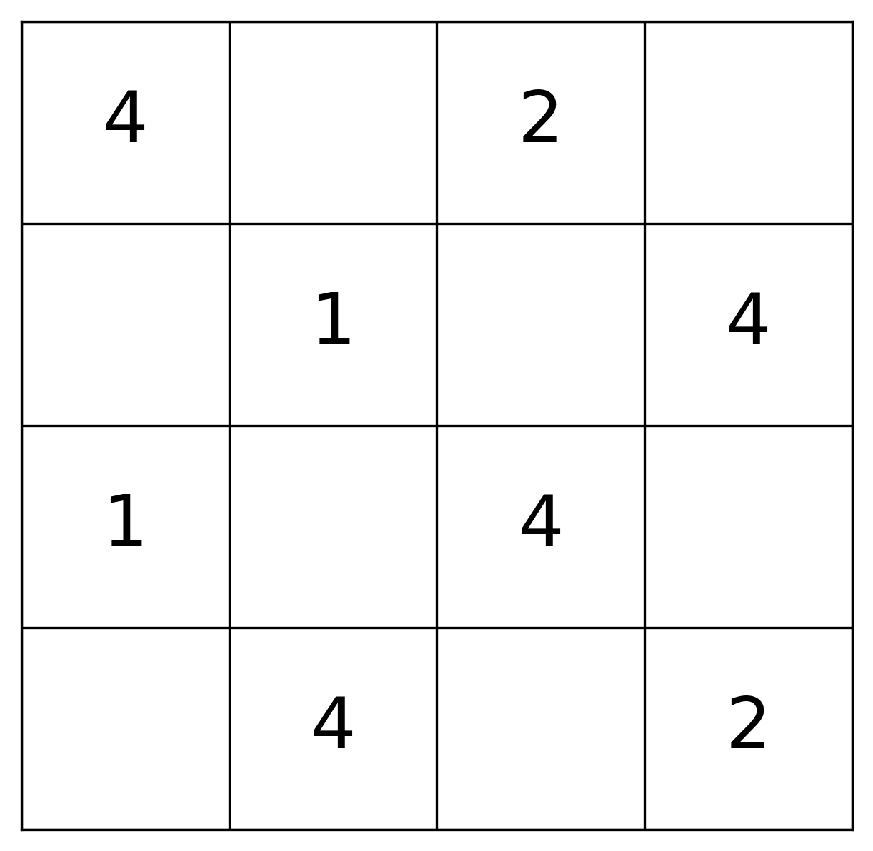
The number of qubits required
Introduction
Exceeds simulator capacity
Within simulator capacity

Slide 9
Methods

Slide 10

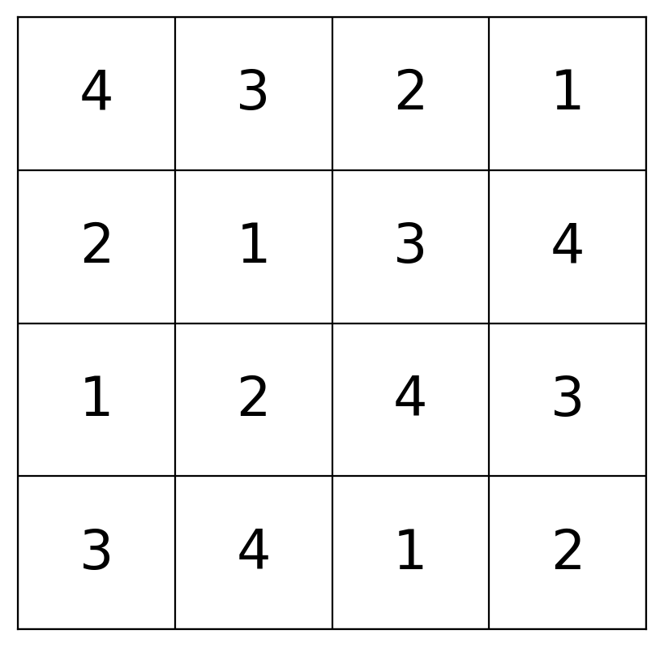
Basic concept
Methods
Assign qubits to each blank.
Construct an oracle which flips a target qubit only if all the conditions are met.
To construct such an oracle, we integrate several parts to judge if each condition is met.
（図で説明する）

Slide 11
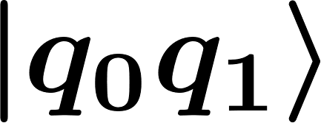
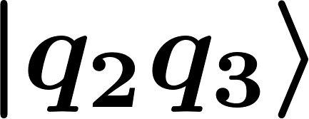
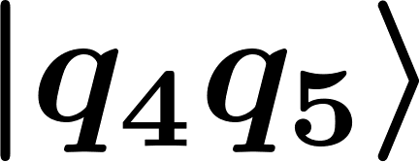
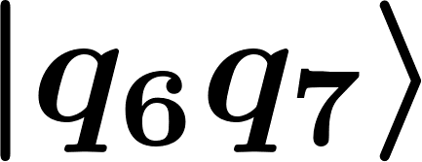
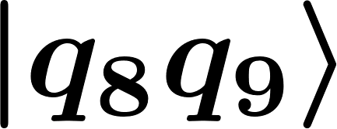
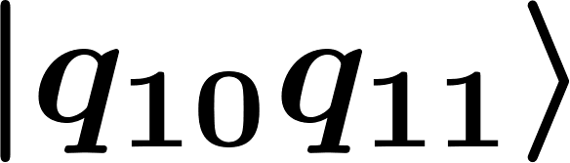
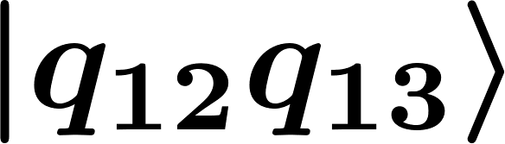
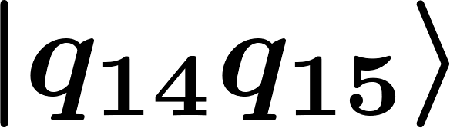
Procedure of Grover’s algorithm
Methods
Qubits initialization
Grover iteration
Oracle (flip target qubit if all conditions are met)
Diffusion (inversion about the average)
Measurement
Notes:
We use 32 qubit of QASM simulator

Slide 12



Preparation of initial states
Methods
Use 2 qubits to represent 1 blank e.g.,
Initialize each qubit according to other filled cells in the same {row, column, block}

Slide 13
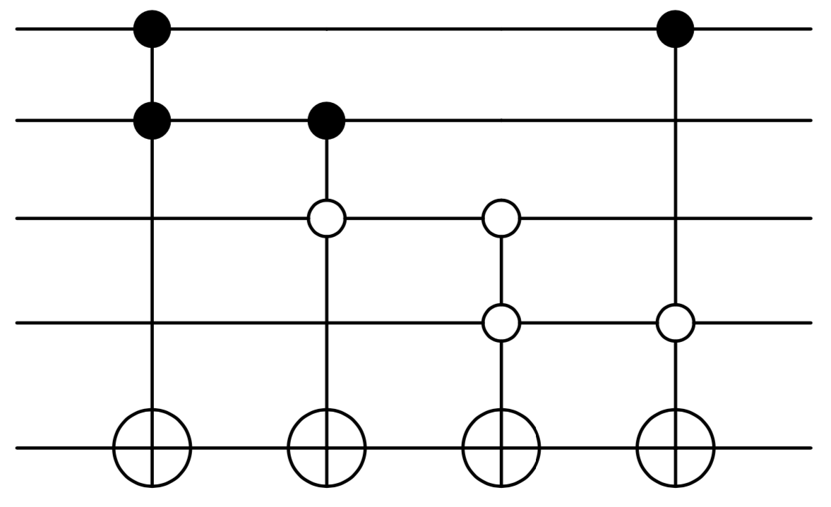





The Oracle
Methods
1. Compare blanks in a {column, row, block}
Circuit to check if two blanks are different
https://github.com/quantum-challenge/2019/blob/master/problems/final/answer_and_comment_by_judges_en.ipynb
→ Flip ancilla qubits only when two blanks have different states
i.e.,
or

Slide 14
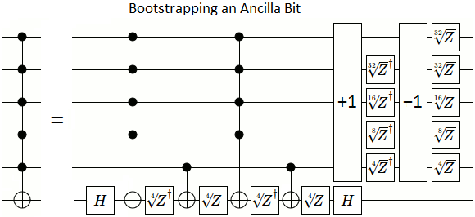
The Oracle
Methods
2. Integrate the ancilla qubits
Multi-control Toffoli gate
→Integrate from 12 parts (rows, columns, blocks)
is stored when
the condition is met
Gives |1> for
correct answer!

Slide 15
Results

Slide 16
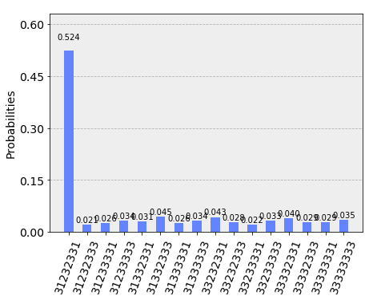
Results
Our method found the answer
with high probability.
It is possible to get higher probability
with more iterations of Grover’s algorithm.
(But it’ll take some hours.)

Slide 17
Results
Input
?
?
?
?
?
?
?
?
?
?
?
?
?
?
?
?

Slide 18
Results
Correct!
Input
?
?
?
?
?
?
?
?
Problem
Number of iterations: 2

Slide 19
Results
Correct!
output
Correct Answer (uniquely determined)
Number of iterations: 2

Slide 20
Results
This is the most difficult Sudoku problem that
our oracle can solve because of the lack of qubits.
?
?
?
?
?
?
?
?
?

Slide 21
Conclusion & Future Work

Slide 22
Conclusion
Future Work
Conclusions & Future Work
We successfully solved limited 4*4 sudoku problems.
Our method needs less steps than brute-force methods of classical computers to solve limited 4*4 sudoku problems.
Reduction of circuit cost and number of qubits used.
Solving arbitary 4*4 sudoku problems.
Solving 9*9 sudoku problems (We need more qubits!!)
Notes:
To sum up, we successfully solved Sudoku with Grover’s algorithm.
But the size of problem is so small for now because of limitation of number of qubits.
We wait IBM to

